Slide 1
R for Car Insurance Product
Claudio G. Giancaterino
29/11/2016
Zurich R User Group - Meetup

Slide 2





Motor Third Party Liability Pricing
By the Insurance contract, economic risk is transferred from the policyholder to the Insurer

Slide 3
Theoretical Approach
P=E(X)=E(N)*E(Z)
P=Risk Premium
X=Global Loss
E(N)=claim frequency
E(Z)=claim severity
Hp:
1) cost of claims are i.i.d.
2) indipendence between number of claims and cost of claims

Slide 4
From Technical Tariff to Commercial Tariff
Tariff variables
P=Pcoll*Yh*Xi*Zj=Technical Tariff
risk coefficients statistical models are employed
Pt=P*(1+λ)/(1-H)=Commercial Tariff
λ=Safety Loading Rate
H=Loading Rate
P is adjusted by tariff requirement

Slide 5
Dataset “ausprivauto0405” within CASdatasets R package
Statistics
> str(ausprivauto0405)
'data.frame': 67856 obs. of 9 variables:
$ Exposure: num 0.304 0.649 0.569 0.318 0.649 ...
$ VehValue: num 1.06 1.03 3.26 4.14 0.72 2.01 1.6 1.47 0.52
$ VehAge: Factor w/ 4 levels "old cars","oldest cars",..: 1 3 3 3 2
$ VehBody: Factor w/ 13 levels "Bus","Convertible",..: 5 5 13 11 5
$ Gender: Factor w/ 2 levels "Female","Male": 1 1 1 1 1 2 2 2 1
$ DrivAge: Factor w/ 6 levels "old people","older work. people",..: 5 2 5 5
$ ClaimOcc: int 0 0 0 0 0 0 0 0 0 0 ...
$ ClaimNb: int 0 0 0 0 0 0 0 0 0 0 ...
$ ClaimAmount: num 0 0 0 0 0 0 0 0 0 0 ...

Slide 6
> table(VehAge,useNA="always")
VehAge
old cars oldest cars young cars youngest cars <NA>
20064 18948 16587 12257 0
> table(DrivAge,useNA="always")
DrivAge
old people older work. people oldest people working people
10736 16189 6547 15767
young people youngest people <NA>
12875 5742 0
> table(VehBody,useNA="always")
VehBody
Bus Convertible Coupe Hardtop
48 81 780 1579
Hatchback Minibus Motorized caravan Panel van
18915 717 127 752
Roadster Sedan Station wagon Truck
27 22233 16261 1750
Utility <NA>
4586 0

Slide 7
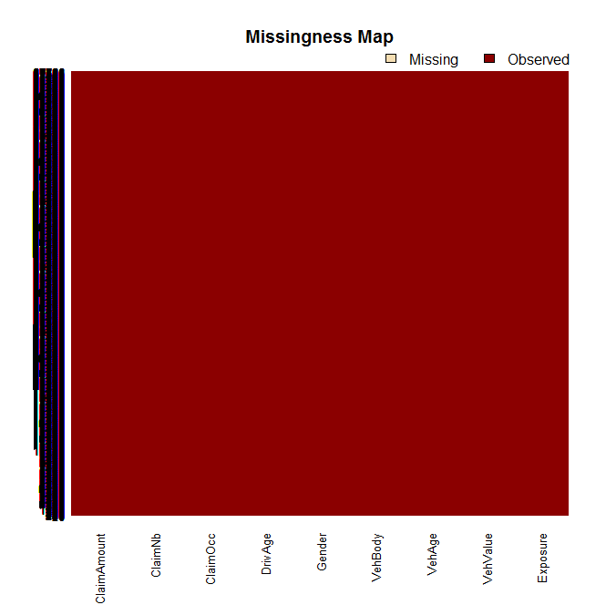
> library(Amelia)
> missmap(ausprivauto0405)

Slide 8
#mean frequency#
> MClaims<-with(rc, sum(ClaimNb)/sum(Exposure))
> MClaims
[1] 0.5471511
#mean severity#
> MACost<-with(rc, sum(ClaimAmount)/sum(ClaimNb))
> MACost
[1] 287.822
#mean risk premium#
> MPremium<-with(rc, sum(ClaimAmount)/sum(Exposure))
> MPremium
[1] 157.4821
> actuallosses<-with(rc.f, sum(ClaimAmount))
> actuallosses
[1] 9342125

Slide 9
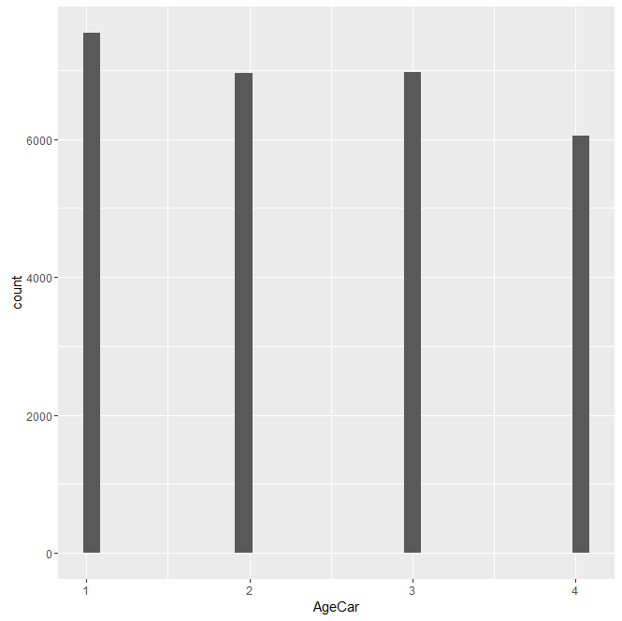
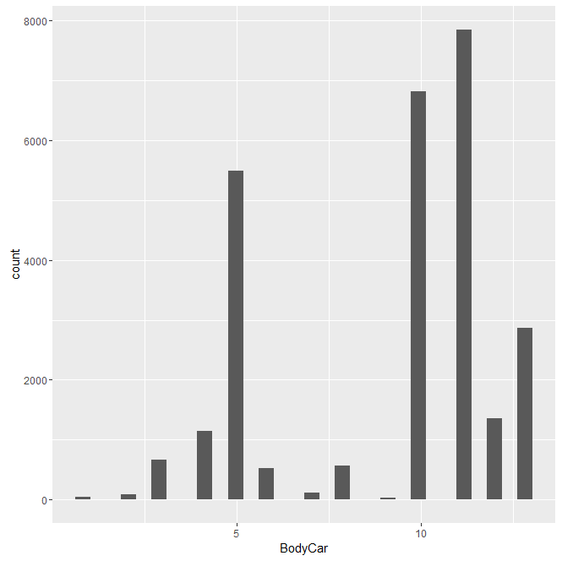
> library(ggplot2)
> ggplot(rc, aes(x = AgeCar))+geom_histogram(stat="bin", bins=30)
> ggplot(rc, aes(x = BodyCar))+geom_histogram(stat="bin", bins=30)
> ggplot(rc, aes(x = AgeDriver))+geom_histogram(stat="bin", bins=30)
> ggplot(rc, aes(x = VehValue))+geom_histogram(stat="bin", bins=30

Slide 10
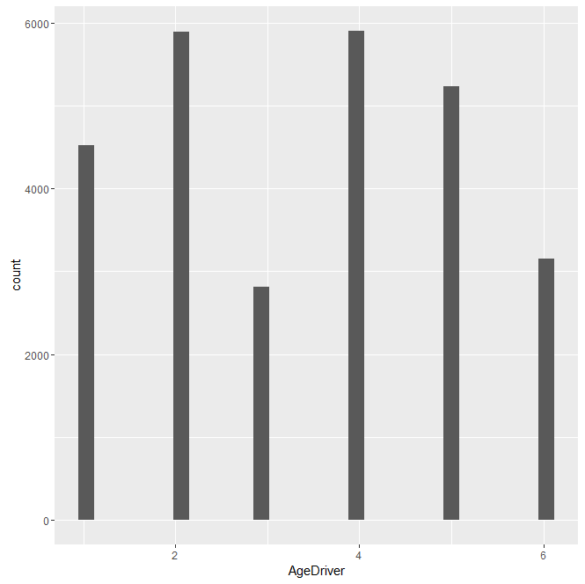
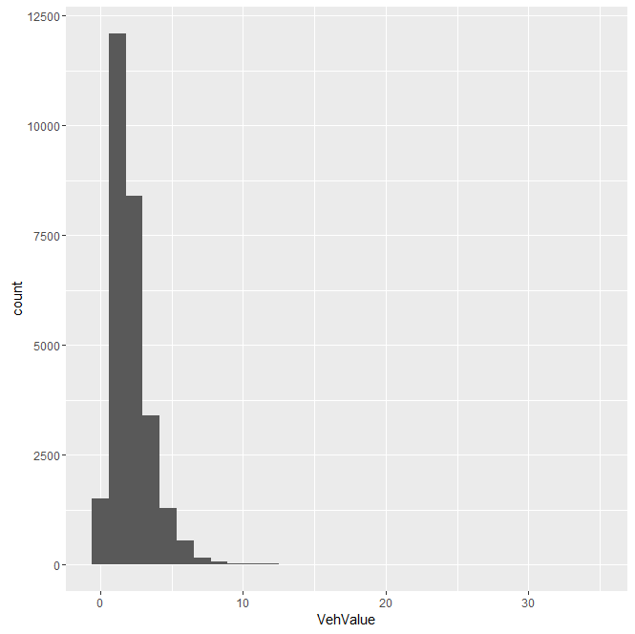

Slide 11
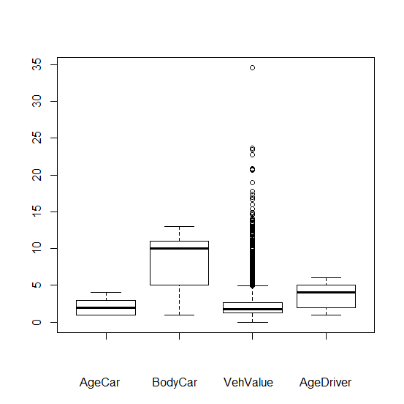
> boxplot(rc$AgeCar,rc$BodyCar,rc$VehValue,rc$AgeDriver,
+ xlab="AgeCar BodyCar VehValue AgeDriver")

Slide 12
Cluster Analysis by k-means
#Prepare Data
> rc.stand<-scale(rc[-1]) # To standardize the variables
#Determine number of clusters
> nk = 2:10
> WSS = sapply(nk, function(k) {
+ kmeans(rc.stand, centers=k)$tot.withinss
+ })
> plot(nk, WSS, type="l", xlab="Number of Clusters",
+ ylab="Within groups sum of squares")
#k-means with k = 7 solutions
> k.means.fit <- kmeans(rc.stand, 7)

Slide 13
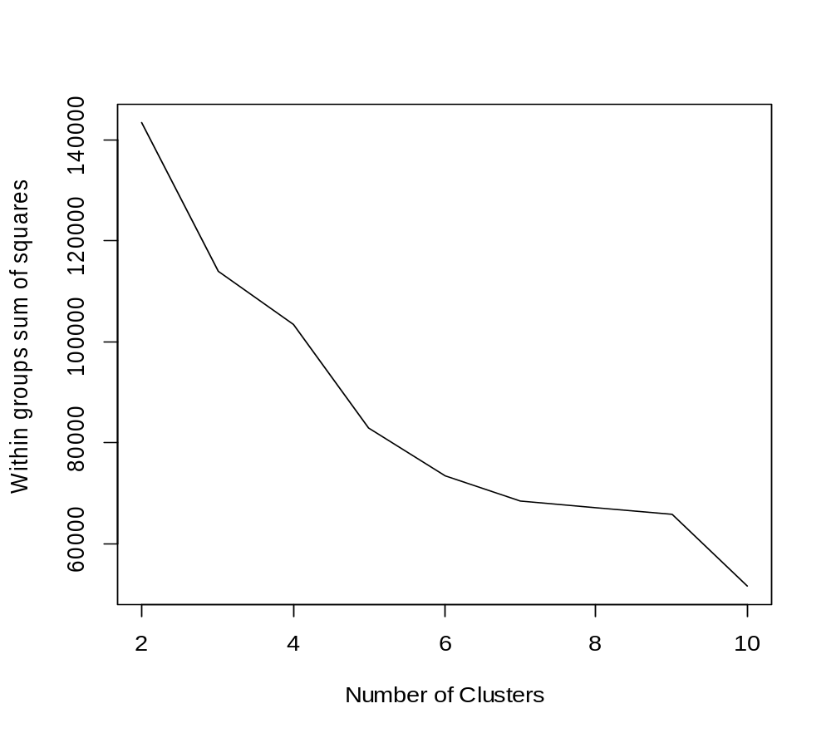

Slide 14
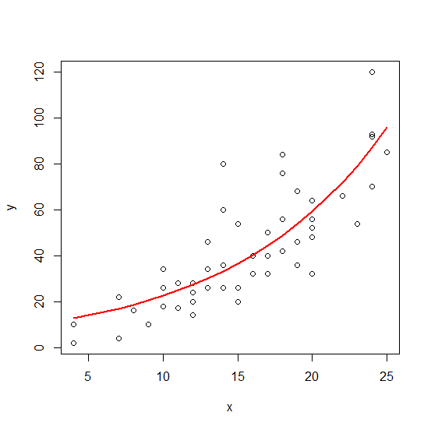
Generalized Linear Models (GLM)
Yi~EF(b(θi);Φ/ωi) g(μi)=ηi ηi=Σjxijβj
Random Component Link Systematic Component
Linear Models are extended in
two directions:
Probability distribution:
Output variables are stochastically
independent with the same exponential
family distribution.
Expected value:
There is a link function between
expected value of outputs and covariates
that could be different from linear
regression.

Slide 15
GLM Analysis
Univariate Approach
#stochastic risk premium with GLM approach#
> PRSModglm1<-glm(RiskPremium1~AgeCar+BodyCar+VehValue+AgeDriver,
+ weights=Exposure, data=rc.f, family=gaussian(link=log))
> GLMSRiskPremium1<-predict(PRSModglm1,data=rc.f,type="response")
Multivariate Approach
#stochastic risk premium with GLM approach#
> PRSModglm2<-glm(RiskPremium2~AgeCar*BodyCar*VehValue*AgeDriver,
+ weights=Exposure, data=rc, family=gaussian(link=log))
> GLMSRiskPremium2<-predict(PRSModglm2,data=rc,type="response")

Slide 16
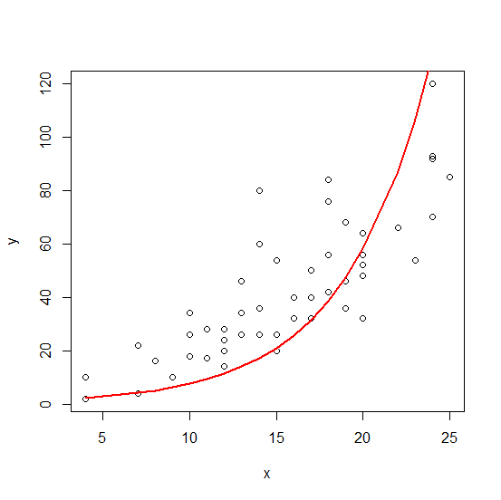
Generalized NonLinear Models (GNM)
Yi~EF(b(θi);Φ/ωi) g(μi)=ηi(xij;βj) ηi=Σjxijβj
Random Component Link Systematic Component
Generalized Linear Models are extended
in the link function where the
systematic component is non linear
in the parameters βj.
It can be considered an extension of
nonlinear least squares model, where the
variance of the output depend on the mean.
Difficult are in starting values, they are
generated randomly for non linear
parameters and using a GLM fit for linear
parameters.

Slide 17
GNM Analysis
Univariate Approach
> library(gnm)
#stochastic risk premium with GNM approach#
> PRSModgnm1<-gnm(RiskPremium1~AgeCar+BodyCar+VehValue+AgeDriver,
+ weights=Exposure, data=rc.f, family=Gamma(link=log))
> GNMSRiskPremium1<-predict(PRSModgnm1,data=rc.f,type="response")
Multivariate Approach
> #stochastic risk premium with GNM approach#
> PRSModgnm2<-gnm(RiskPremium2~VehValue*AgeDriver*AgeCar*BodyCar,
+ weights=Exposure, data=rc, family=Gamma(link=log))
> GNMSRiskPremium2<-predict(PRSModgnm2,data=rc,type="response")

Slide 18
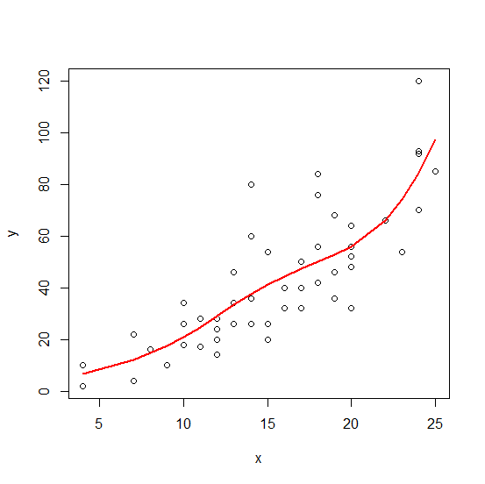
Generalized Additive Models (GAM)
Yi~EF(b(θi);Φ/ωi) g(μi)=ηi ηi= Σpxipβip+Σjfj(xij)
Random Component Link Systematic Component
Generalized additive models extend
generalized linear models in the predictor:
systematic component is made up by one
parametric part and one non parametric part
built by the sum of unknown “smoothing”
functions of the covariates.
For the estimators are used splines,
functions made up by combination of
little polynomial segment joined in knots.

Slide 19
GAM Analysis
Univariate Approach
> library(mgcv)
#stochastic risk premium with GAM approach#
> PRSModgam1<-gam(RiskPremiumgam1~s(AgeCar, bs="cc", k=4)
+ +s(BodyCar, bs="cc", k=12)+s(VehValue, bs="cc", k=30)
+ +s(AgeDriver, bs="cc", k=6), weights=Exposure, data=rc,
+ family=Gamma(link=log))
> GAMSRiskPremium1<-predict(PRSModgam1,data=rc,type="response")
Multivariate Approach
> #stochastic risk premium with GAM approach#
> PRSModgam2<gam(RiskPremiumgam2~te(BodyCar,VehValue,AgeDriver,AgeCar,
+ k=4),weights=Exposure, data=rc, family="Gamma"(link=log))
> GAMSRiskPremium2<-predict(PRSModgam2,data=rc,type="response")
> rc$GAMSRiskPremium2<-with(rc, GAMSRiskPremium2)

Slide 20
Results
 |  | Mean commercial tariff | Tariff requirement | Loss Ratio | Residuals degrees of freedom | Expected Losses | Actual Losses | Explained Deviance | Risk coefficients
Uni- | GLM | 234,4587 | 1,000490 | 1,447822 | 27.501 | 9.337.547 | 9.342.125 | 96,96% | 20
Variate | GNM | 234,4647 | 1,000476 | 1,447785 | 27.501 | 9.337.683 | 9.342.125 | 96,96% | 20
Analysis | GAM | 232,8702 | 1,001729 | 1,457698 | 27.476 | 9.325.999 | 9.342.125 | 96,20% | 45
Multi- | GLM | 234,6486 | 0,9981246 | 1,446650 | 27.505 | 9.359.678 | 9.342.125 | 87,64% | 16
Variate | GNM | 234,6165 | 0,9979703 | 1,446848 | 27.505 | 9.361.125 | 9.342.125 | 87,04% | 16
Analysis | GAM | 248,5732 | 0,8596438 | 1,365612 | 27.265 | 10.867.438 | 9.342.125 | 84,80% | 256

Slide 21
GLM vs GAM vs GNM Approaches
GLM GAM GNM
Strengths: -User-friendly -Flexible to fit data -Afford some
-Faster elaboration -Realistic values elaboration -Usually low level of excluded by GLM
residual deviance
-More risk coefficients -Better values despite GLM
Weakness: -Poor flexibility -Complex to realize -Complex to use
to fit data
-Usually higher
values of residual
deviance
-Overestimed values

Slide 22
References
C.G. Giancaterino - GLM, GNM and GAM Approaches on MTPL Pricing - Journal of Mathematics and Statistical Science – 08/2016
http://www.ss-pub.org/journals/jmss/vol-2/vol-2-issue-8-august-2016/
X.Marechal & S. Mahy – Advanced Non Life Pricing – EAA Seminar
N. Savelli & G.P. Clemente – Lezioni di Matematica Attuariale delle Assicurazioni Danni – Educatt

Slide 23
Many Thanks for your Attention!!!
Contact:
Claudio G. Giancaterino
c.giancaterino@gmail.com

